Slide 1
Software Defined Networking (SDN) training
Module 2: Hyper-V Network Virtualization

Slide 2
Copyright and terms of use
Copyright and trademarks
This training package is proprietary and confidential and is intended only for uses described in the training materials. Content and software is provided to you under a Non-Disclosure Agreement and cannot be distributed. Copying or disclosing all or any portion of the content and/or software included in such packages is strictly prohibited.
The contents of this package are for informational and training purposes only and are provided "as is" without warranty of any kind, whether express or implied, including but not limited to the implied warranties of merchantability, fitness for a particular purpose, and non-infringement.
Conditions and terms of use
Training package content, including URLs and other Internet Web site references, is subject to change without notice. Because Microsoft must respond to changing market conditions, the content should not be interpreted to be a commitment on the part of Microsoft, and Microsoft cannot guarantee the accuracy of any information presented after the date of publication. Unless otherwise noted, the companies, organizations, products, domain names, e-mail addresses, logos, people, places, and events depicted herein are fictitious, and no association with any real company, organization, product, domain name, e-mail address, logo, person, place, or event is intended or should be inferred.

Slide 3
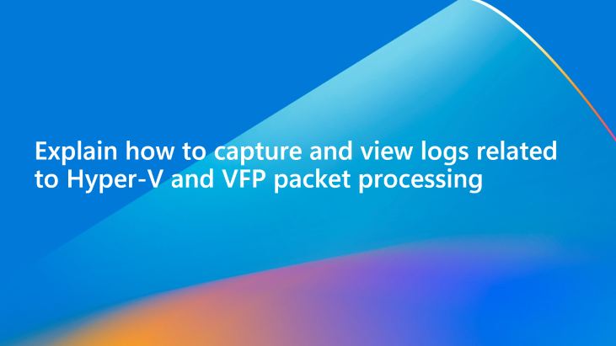
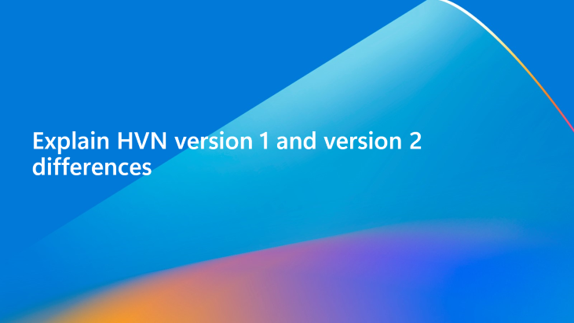
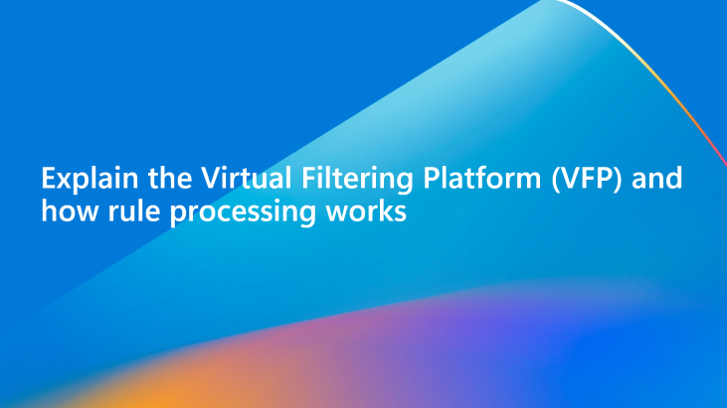
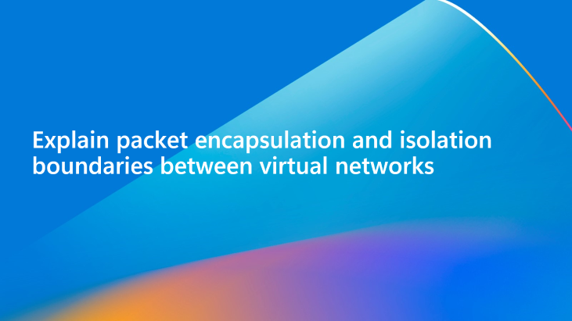
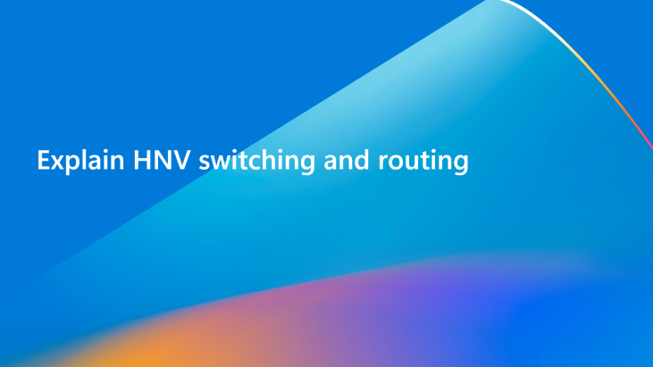
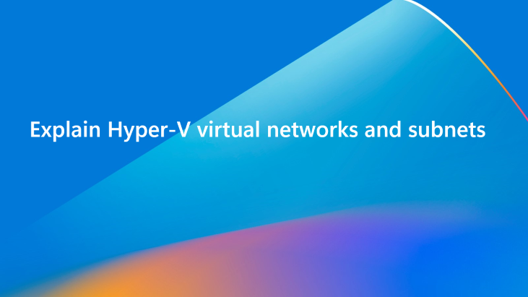
Learning objectives
By the end of this module, you will be able to:

Slide 4
Explain HVN version 1 and version 2 differences

Slide 5
Introduction
Introduced in Windows Server 2012, Hyper-V Network Virtualization (HNV) enables virtualization of networks on top of a shared physical network infrastructure.
HNV is a fundamental building block of Microsoft's updated Software Defined Networking (SDN) solution and is fully integrated into the SDN stack.
Flexibility in virtual machine (VM) placement makes it possible to move workloads anywhere in the datacenter without changing the VMs or reconfiguring the networks.

Slide 6
HNV version 1
Originally introduced with Windows Server 2012 R2.
Relies on Windows Management Instrumentation (WMI) and Windows PowerShell to define isolation settings, Customer Address (CA), Virtual Network, and Provider Address (PA) mappings and routing.
No new features have been added to HNV version 1.
Notes:
HNV version 1 is compatible with Windows Server 2012 R2 and System Center 2012 R2 Virtual Machine Manager (VMM). Configuration for HNV v1 relies on WMI management and Windows PowerShell cmdlets (facilitated through System Center VMM) to define isolation settings and Customer Address (CA) to virtual network to Physical Address (PA) mappings and routing. No additional features have been added to HNV v1 in Windows Server 2016 and no new features are planned.

Slide 7
HNV version 2
Relies on the Azure Virtual Filtering Platform (VFP) extension within the Hyper-V switch.
Policies are defined in Microsoft Network Controller using the RESTful NorthBound API and plumbed to the Host Agent via multiple Southbound Interfaces (SBI) including the Open vSwitch Database (OVSDB).
Host Agent program policy is contained in the VFP of Hyper-V.
Topics covered in all training modules are based on HNV version 2.
Notes:
A significant number of new features are included in HNV version 2 that are implemented using the Azure Virtual Filtering Platform (VFP) forwarding extension in the Hyper-V Switch. HNV v2 is fully integrated with Microsoft Azure Stack HCI, which includes the new Network Controller in the Software Defined Networking (SDN) stack.
Virtual network policy is defined through the Microsoft Network Controller using a RESTful NorthBound (NB) API and plumbed to a host agent via multiple SouthBound Interfaces (SBI) including OVSDB. The host agent programs policy in the VFP extension of the Hyper-V Switch is where it is enforced.

Slide 8
Knowledge check – HNV
How are policies programmed in HNV version 1 versus version 2?
Notes:
See answers at end of the deck.

Slide 9
Explain Hyper-V virtual networks and subnets

Slide 10
Virtual networks
A virtual network forms an isolation boundary where the VMs within a virtual network can only communicate with each other.
Each virtual network consists of one or more virtual subnets.
Isolation is enforced by either Network Virtualization Using Generic Routing Encapsulation (NVGRE) or Virtual Extensible LAN (VXLAN) encapsulation to create overlay networks allowing overlapping of IP subnets between tenants.
Each virtual network has a unique Routing Domain ID (RDID) on the host.
The physical network on which each tenant's encapsulated traffic is tunneled is represented by a logical network called the provider logical network.
Notes:
Software Defined Networking (SDN) in Windows Server 2016 is based on programming policy for overlay virtual networks within a Hyper-V virtual switch. You can create overlay virtual networks, also called virtual networks, with Hyper-V Network Virtualization.
When you deploy Hyper-V Network Virtualization, overlay networks are created by encapsulating the original tenant virtual machine's Layer-2 Ethernet frame with an overlay - or tunnel - header (for example, VXLAN or NVGRE) and Layer-3 IP and Layer-2 Ethernet headers from the underlay (or physical) network. The overlay virtual networks are identified by a 24-bit Virtual Network Identifier (VNI) to maintain tenant traffic isolation and to allow overlapping IP addresses. The VNI is composed of a virtual subnet ID (VSID), logical switch ID, and tunnel ID.
Additionally, each tenant is assigned a routing domain (similar to virtual routing and forwarding - VRF) so that multiple virtual subnet prefixes (each represented by a VNI) can be directly routed to each other.
The physical network on which each tenant's encapsulated traffic is tunneled is represented by a logical network called the provider logical network. This provider logical network consists of one or more subnets, each represented by an IP prefix and, optionally, a VLAN 802.1q tag.
You can create additional logical networks and subnets for infrastructure purposes to carry management traffic, storage traffic, and live migration traffic.
Microsoft SDN does not support the isolation of tenant networks by using VLANs. Tenant isolation is accomplished solely by using Hyper-V Network Virtualization overlay virtual networks and encapsulation.

Slide 11
Virtual subnets
A virtual subnet implements the Layer 3 IP subnet semantics for VMs in the same virtual subnet.
Forms a broadcast domain similar to a VLAN.
Isolation enforced by:
NVGRE Tenant Network ID (TNI)
VXLAN Network Identifier (VNI)
Each virtual subnet belongs to a single virtual network (RDID) and is assigned a unique Virtual Subnet ID (VSID) using either a TNI or VNI key in the encapsulated packet header.
Notes:
A virtual subnet implements the Layer 3 IP subnet semantics for the virtual machines in the same virtual subnet. The virtual subnet forms a broadcast domain (similar to a VLAN) and isolation is enforced by using either the NVGRE Tenant Network ID (TNI) or VXLAN Network Identifier (VNI) field.
Each virtual subnet belongs to a single virtual network (RDID), and it is assigned a unique Virtual Subnet ID (VSID) using either the TNI or VNI key in the encapsulated packet header. The VSID must be unique within the datacenter and is in the range 4096 to 2^24-2.

Slide 12
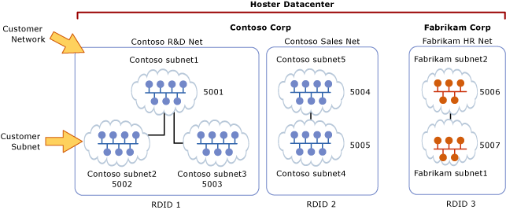
Virtual subnets
Each tenant can have their own network topology.
Isolation boundary is the virtual network that prevents communication with other virtual networks.
Notes:
A key advantage of the virtual network and routing domain is that it allows customers to bring their own network topologies (for example, IP subnets) to the cloud. The figure shows an example where Contoso Corp has two separate networks, the R&D Net and the Sales Net. Because these networks have different routing domain IDs, they cannot interact with each other. That is, Contoso R&D Net is isolated from Contoso Sales Net even though both are owned by Contoso. Contoso R&D Net contains three virtual subnets. Note that both the RDID and VSID are unique within a datacenter.
Layer 2 Forwarding​
In the figure, the virtual machines in VSID 5001 can have their packets forwarded to virtual machines that are also in VSID 5001 through the Hyper-V Switch. The incoming packets from a virtual machine in VSID 5001 are sent to a specific vPort on the Hyper-V Switch. Ingress rules (e.g. encapsulation) and mappings (e.g. encapsulation header) are applied by the Hyper-V switch for these packets. The packets are then forwarded either to a different vPort on the Hyper-V Switch (if the destination virtual machine is attached to the same host) or to a different Hyper-V switch on a different host (if the destination virtual machine is located on a different host).​
​
Layer 3 Routing​
Similarly, the virtual machines in VSID 5001 can have their packets routed to virtual machines in VSID 5002 or VSID 5003 by the HNV distributed router which is present in each Hyper-V host’s vSwitch. Upon delivering the packet to the Hyper-V switch, HNV updates the VSID of the incoming packet to the VSID of the destination virtual machine. This will only happen if both VSIDs are in the same RDID. Therefore, virtual network adapters with RDID1 cannot send packets to virtual network adapters with RDID2 without traversing a gateway.​
​
Each virtual subnet defines a Layer 3 IP subnet and a Layer 2 (L2) broadcast domain boundary similar to a VLAN. When a virtual machine broadcasts a packet, HNV uses Unicast Replication (UR) to make a copy of the original packet and replace the destination IP and MAC with the addresses of each VM which are in the same VSID.​
​
In addition to being a broadcast domain, the Virtual Subnet ID (VSID) or VXLAN Network Identifier (VNI) provides isolation. A virtual network adapter in HNV is connected to a Hyper-V switch port that will have ACL rules applied either directly to the port (virtualNetworkInterface REST resource) or to the virtual subnet (VSID) of which it is a part.​
​
The Hyper-V switch port must have an ACL rule applied. This ACL could be ALLOW ALL, DENY ALL, or be more specific to only allow certain types of traffic based on 5-tuple (Source IP, Destination IP, Source Port, Destination Port, Protocol) matching.

Slide 13
Knowledge check – Virtual networks and subnets
How is isolation achieved between virtual networks?​
Can subnets within the same virtual network communicate with each other?​
Can subnets in different virtual networks communicate with each other?​
What is the logical network called that the encapsulated traffic traverses?
Notes:
See answers at end of the deck.

Slide 14
Explain HNV switching and routing

Slide 15
Switching and routing
HNV functions like a normal physical switch or router.
A VM connecting to another VM in the same Virtual Subnet ID (VSID) needs to know the Customer Address (CA) MAC address of the remote VM.
Utilizes standard Address Resolution Protocol (ARP) entries and discovery methods:
Source VM will check ARP cache for entry for remote VM.
If this doesn’t exist, sends ARP request that will be intercepted by the Hyper-V switch and forwarded to the network controller Host Agent.
Host Agent will look in its local database.
Host Agent will inject an ARP response and send back to the source VM.
Source VM functions as normal to send packet to remote VM, with Hyper-V switch intercepting and applying appropriate VFP rules and policies against the packet to route appropriately within the data plane.
Notes:
HNV v2 implements correct Layer 2 (L2) switching and Layer 3 (L3) routing semantics to work just as a physical switch or router would work. When a virtual machine connected to an HNV virtual network attempts to establish a connection with another virtual machine in the same virtual subnet (VSID) it will first need to learn the CA MAC address of the remote virtual machine. If there is an ARP entry for the destination virtual machine’s IP address in the source virtual machine’s ARP table, the MAC address from this entry is used. If an entry does not exist, the source virtual machine will send an ARP broadcast with a request for the MAC address corresponding to the destination virtual machine’s IP address to be returned. The Hyper-V Switch will intercept this request and send it to the Host Agent. The Host Agent will look in its local database for a corresponding MAC address for the requested destination virtual machine’s IP address.​
​
NOTE: The Host Agent, acting as the OVSDB server, uses a variant of the VTEP schema to store CA-PA mappings, MAC table, and so on.​
​
If a MAC address is available, the Host Agent injects an ARP response and sends this back to the virtual machine. After the virtual machine’s networking stack has all the required L2 header information, the frame is sent to the corresponding Hyper-V Port on the V-Switch. Internally, the Hyper-V Switch tests this frame against N-tuple matching rules assigned to the V-Port and applies certain transformations to the frame based on these rules. Most importantly, a set of encapsulation transformations is applied to construct the encapsulation header using VXLAN, depending on the policy defined at the Network Controller. Based on the policy programmed by the Host Agent, a CA-PA mapping is used to determine the IP address of the Hyper-V host where the destination virtual machine resides. The Hyper-V Switch ensures the correct routing rules and VLAN tags are applied to the outer packet so it reaches the remote PA address.​
​
If a virtual machine connected to an HNV virtual network wants to create a connection with a virtual machine in a different virtual subnet (VSID), the packet needs to be routed accordingly. HNV assumes a star-topology where there is only one IP address in the CA space used as the next-hop to reach all IP prefixes (meaning one default route/gateway). Currently, this enforces a limitation to a single default route and non-default routes are not supported.​

Slide 16
Routing between virtual subnets
Default gateway is needed to bridge layer 2 (L2 domains),​ which in typical physical networks is the router.​
HNV uses a built-in router that is part of every host to form a distributed router for a virtual network​.
There is a vNIC on the vSwitch that acts as the default gateway for all traffic going between virtual subnets that are part of the same VSID/VNI network​.
Default gateway defaults to the lowest IP address in the VSID/VNI and is assigned to the Distributed Router.
Distributed Router can directly route traffic to the appropriate host without an intermediary.
Packet never has to leave the physical host in scenarios where the VMs are located on the same physical host if they are within the same VSID/VNI.
Notes:
In a physical network, an IP subnet is a Layer 2 (L2) domain where computers (virtual and physical) can directly communicate with each other. The L2 domain is a broadcast domain where ARP entries (IP:MAC address map) are learned through ARP requests that are broadcast on all interfaces and ARP responses are sent back to the requesting host. The computer uses the MAC information learned from the ARP response to completely construct the L2 frame including Ethernet headers. However, if an IP address is in a different L3 subnet, the ARP request does not cross this L3 boundary. Instead, an L3 router interface (next-hop or default gateway) with an IP address in the source subnet must respond to these ARP requests with its own MAC address.​
​
In standard Windows networking, an administrator can create static routes and assign these to a network interface. Additionally, a “default gateway” is usually configured to be the next-hop IP address on an interface where packets destined for the default route (0.0.0.0/0) are sent. Packets are sent to this default gateway if no specific routes exist. This is typically the router for your physical network. HNV uses a built-in router that is part of every host and has an interface in every VSID to create a distributed router for the virtual network(s).​
​
Since HNV assumes a star topology, the HNV distributed router acts as a single default gateway for all traffic that is going between virtual subnets that are part of the same VSID network. The address used as the default gateway defaults to the lowest IP address in the VSID and is assigned to the HNV distributed router. This distributed router allows for a very efficient way for all traffic inside a VSID Network to be routed appropriately because each host can directly route the traffic to the appropriate host without needing an intermediary. This is particularly true when two virtual machines in the same VM network but different virtual subnets are on the same physical host. As you will see later in this section, the packet never has to leave the physical host.​

Slide 17
Routing outside a virtual network
HNV gateways are required to allow communication between virtual and physical networks​.
Infrastructures requiring an HNV gateway include private cloud and hybrid cloud​.
Required for Layer 3 (L3) routing between internal and external (physical) networks (including NAT) or between different sites or clouds that use an IPSEC VP​N or GRE tunnel.
Gateways can be either Windows Server running Routing and Remote Access Service (RRAS), a Top-of-Rack (TOR) switch acting as a VXLAN gateway, access through a Virtual IP (VIP) advertised by the load balancer, or a Network Virtual Appliance (NVA).
Notes:
Most customer deployments will require communication from the HNV environment to resources that are not part of the HNV environment. Network Virtualization gateways are required to allow communication between the two environments. Infrastructures requiring an HNV Gateway include Private Cloud and Hybrid Cloud. Basically, HNV gateways are required for Layer 3 routing between internal and external (physical) networks (including NAT) or between different sites and/or clouds (private or public) which use an IPSec VPN or GRE tunnel.​
​
NOTE: GRE tunnels are not supported with Azure Stack for GA as configuration options not exposed via ARM. Underlying infrastructure can support once capability added to ARM.​
​
Gateways can come in different physical form factors. They can be built on Windows Server 2016 Technical Preview, incorporated into a Top of Rack (TOR) switch acting as a VXLAN Gateway, accessed through a Virtual IP (VIP) advertised by a load balancer, put into other existing network appliances, or can be a new stand-alone network virtual appliance.​

Slide 18
Knowledge check – Switching and routing
How does a VM machine learn L2 routes to another VM in the same subnet?​
What is the IP address of the default router for a VM deployed on a virtual network?​
What is required to route traffic to or from a virtual network and physical network?
Notes:
See answers at end of the deck.

Slide 19
Explain packet encapsulation and isolation boundaries between virtual networks

Slide 20
Packet encapsulation
Customer Address (CA)
The IP address assigned by the customer, based on their intranet infrastructure.
This address allows the customer to exchange network traffic with the VM as if it had not been moved to a public or private cloud.
The CA is visible to the VM and reachable by the customer.
Provider Address (PA)
The IP address assigned by the hosting provider, or by the datacenter administrator based on the physical network infrastructure.
The PA appears in the packets on the network that are exchanged with the server running Hyper-V that is hosting the VM.
The PA is visible on the physical network, but not to the VM.

Slide 21
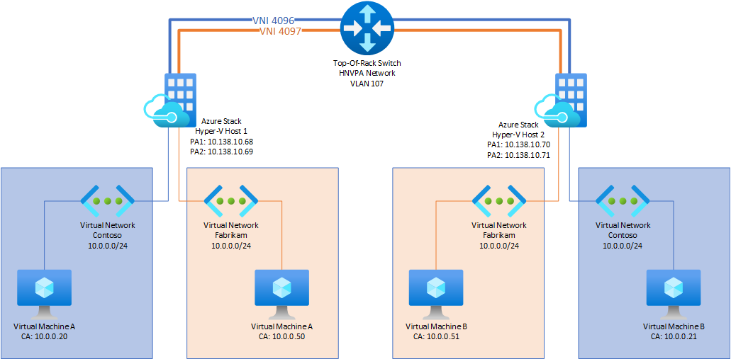
Packet encapsulation
Each VM CA is mapped to a physical host PA.
VMs send data packets in the CA spaces, which are put into an envelope with a PA source and destination pair based on the mapping.
The CA-PA mappings must allow the hosts to differentiate packets for different VMs.
Notes:
The Customer Addresses (CA) maintain the customer's network topology, which is virtualized and decoupled from the actual underlying physical network topology and addresses, as implemented by the Provider Addresses (PA). The traffic is encapsulated with VXLAN or NVGRE headers to isolate the traffic. If using NVGRE, this will be called the Virtual Subnet Identifier (VSID). If using VXLAN, this will be called the VXLAN Network Identifier (VNI). This encapsulated traffic will traverse the HNVPA network to route packets between the Provider Addresses that are assigned to the Hyper-V hosts.
In the diagram above, VM A deployed on Contoso vNet will send a packet intended for 10.0.0.21. This CA will have a corresponding PA address on the Hyper-V host which informs the vSwitch how to route the packet accordingly. A 'shipping label' is attached to the original packet and then routed across the HNVPA network, where the packet will be received by the other Hyper-V host and be de-encapsulated. Likewise, when VM B responds, the same process is followed by performing a PA:CA mapping lookup to route the packet back to VM A.

Slide 22
Overlay networks
HNV implements overlay networks using one of two methods:
Network Virtualization Generic Routing Encapsulation (NVGRE)
Virtual eXtensible Local Area Network (VXLAN)
Maximum transmission units (MTUs) on the physical network must be increased to support the additional header.
SDN environments require a minimum of 1,660 MTUs on the physical network for switches and network adapters.

Slide 23
VXLAN overview
Originally developed by Cisco, Arista, and VMware with RFC 7348 published in August 2014.
Designed to solve VLAN limitations in datacenters and cloud by using a 24-bit VXLAN identifier (VNI) allowing up to 16 million VXLAN segments within the same domain.
VXLAN is the industry standard and default encapsulation used by SDN Network Controller.
Notes:
The Virtual eXtensible Local Area Network (VXLAN) RFC 7348 protocol has been widely adopted in the marketplace, with support from vendors like Cisco, Brocade, Arista, Dell, HP and others.

Slide 24
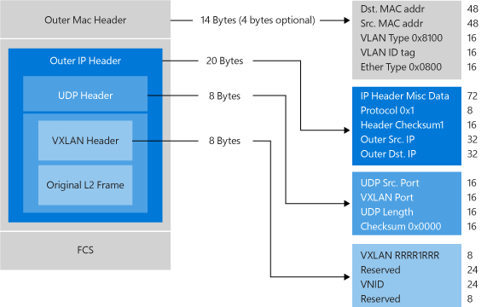
VXLAN packet header
Notes:
VXLAN Header: 8-byte field that contains the flags and the VXLAN Segment ID/VXLAN Network Identifier and the Reserved fields.
Outer UDP Header: This is the outer UDP header with source port provided by the VTEP and destination port being a well-known UDP port.
Outer IP Header: This is the outer IP header with the source IPaddress indicating the IP address of the VTEP over which the communicating VM (as represented by the inner source MAC address) is running. The destination port number is fixed at 4789. Source port is calculated using a hash algorithm based on the original ethernet frame.
Outer Ethernet Header: Also called the Outer MAC Header. Contains the MAC address of the VTEP connected to source VM. Destination MAC address is the MAC address of the next hop to the destination VTEP.

Slide 25
VXLAN route mapping
As defined in the VXLAN RFC 7348, there are several approaches for distribution of the VTEP IP to VM MAC mapping​:
Microsoft VXLAN simple learning-based control plane​
Central authority/directory-based lookup​
Distribution of mapping information to VTEPs by the central authority​
Microsoft VXLAN implementation utilizes the distribution by central authority method (Network Controller) to send out the VM MAC to VTEP IP mappings​.
Network Controller (OVSDB client) communicates with the Hyper-V Hosts (VTEPs) using the OVSDB protocol with policy represented in schemas persisted in the Host Agent’s database (OVSDB Server)​.
Host Agent database contains the VTEP IP address of all hosts attached to the virtual subnet​.
Host Agent program mapping rules into the VFP extension of the Hyper-V Switch to correctly encapsulate and send the VM packet based on the destination VM.
Notes:
The VXLAN RFC talks about different approaches for distributing the VTEP IP to VM MAC mapping information:​
Learning-based control plane​
Central Authority-/directory-based lookup​
Distribution of this mapping information to the VTEPs by the central authority​
​
In a learning-based control-plane, encapsulated packets having an unknown destination (VTEP IP) are sent out via broadcast or to an IP multicast group. This requires a mapping between a multicast group and each virtual subnet (identified by a VXLAN Network Identifier (VNI)) such that any VTEPs which host VMs attached to this VNI register for the group through IGMP. The VM MAC addresses and remote host’s IP address (VTEP IP) are then discovered via source-address learning. A clear disadvantage of this approach is that it places a lot of unnecessary traffic on the wire which most network administrators try to avoid.​
​
Based on our learnings in Azure, Microsoft chose the distribution by a central authority (i.e. Microsoft Network Controller) approach to send out the VM MAC : VTEP IP mapping information to avoid the unnecessary broadcast/multicast network traffic. The Microsoft Network Controller (OVSDB Client) communicates with the Hyper-V Hosts (VTEPs) using the OVSDB protocol with policy represented in schemas persisted to a Host Agent’s database (OVSDB Server). A local ARP responder on the host is then able to catch and respond to all ARP requests from the VMs to provide the destination MAC address of the remote VM. The Host Agent database also contains the VTEP IP address of all hosts attached to the virtual subnet. The Host Agent programs mapping rules into the VFP extension of the Hyper-V Virtual Switch to correctly encapsulate and send the VM packet based on the destination VM.​

Slide 26
NVGRE overview
Network Virtualization Generic Routing Encapsulation (NVGRE) standard was proposed by Microsoft, Intel, HP, and Dell in RFC 7637.
Can support up to 16 million LAN segments within the same domain.
Very similar concepts with VXLAN, which is a competing encapsulation method.

Slide 27
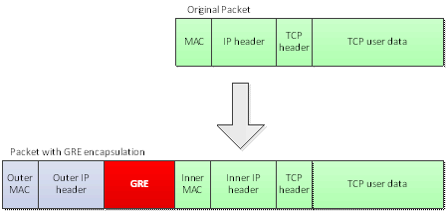
NVGRE packet header
Leverages the lower 24 bits of a GRE header as the Tenant Network Identifier (TNI).
VM packet is encapsulated inside another packet.
The packet header contains the appropriate source and destination provider address (PA).
Notes:
Hyper-V Network Virtualization supports Network Virtualization using Generic Routing Encapsulation (NVGRE) as the mechanism to virtualize IP addresses. In NVGRE, the virtual machine's packet is encapsulated inside another packet. The header of this new, NVGRE-formatted packet has the appropriate source and destination provider area (PA) IP addresses. In addition, it has a 24-bit Virtual Subnet ID (VSID), which is stored in the GRE header of the new packet.
The following figure shows a GRE-encapsulated packet. On the wire, NVGRE-encapsulated packets look like IP-over-Ethernet packets, except that the payload of the outer IP header is a GRE-encapsulated IP packet (including the Ethernet header).

Slide 28
Knowledge check – Packet encapsulation
What is the Customer Address?​
What is the Provider Address?​
What is the default encapsulation type for virtual networks managed by Network Controller?
Notes:
See answers at end of the deck.

Slide 29
Explain the Virtual Filtering Platform (VFP) and how rule processing works

Slide 30
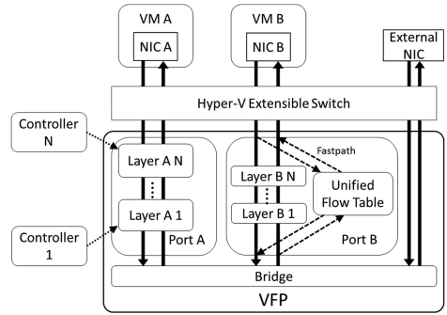
Virtual Filtering Platform (VFP)
VFP operates on top of Hyper-V’s extensible switch as a packet filter.
A programming model based on layer and Match Action Tables (MAT).
Includes a fastpath through Unified Flow Tables and a classifier used to match rules in the MAT layers.
Provides core SDN functionality for Azure networking services including:
Address virtualization for VNET
VIP to DIP translation for SLB
ACLs, Metering, QoS, Security Guards
Supports all Azure data plane policies at 40GbE+ with offloads.
Notes:
VFP operates on top of Hyper-V’s extensible switch as a packet filter. Its programming model is based on layers, MATs that support a multi-controller model. VFP’s packet processor includes a fast path-through Unified Flow Tables and a classifier used to match rules in the MAT layers.

Slide 31
Virtual Filtering Platform (VFP)
The core VFP model assumes a switch with multiple ports that are connected to virtual NICs (vNICs).
VFP filters traffic from a vNIC to the switch, and from the switch to a vNIC.
VFP policies are associated to a specific port.
From the perspective of a VM with vNIC attached to a port:
Ingress traffic to the switch is considered outbound traffic from the VM.
Egress traffic from the switch is considered inbound traffic to the VM.
VFP API and policies are based on outbound and inbound flows.
Notes:
The core VFP model assumes a switch with multiple ports that are connected to virtual NICs (VNICs). VFP filters traffic from a VNIC to the switch, and from the switch to a VNIC. All VFP policy is attached to a specific port. From the perspective of a VM with a VNIC attached to a port, ingress traffic to the switch is considered to be “outbound” traffic from the VM, and egress traffic from the switch is considered to be “inbound” traffic to the VM. VFP’s API and its policies are based on the inbound/outbound model.

Slide 32
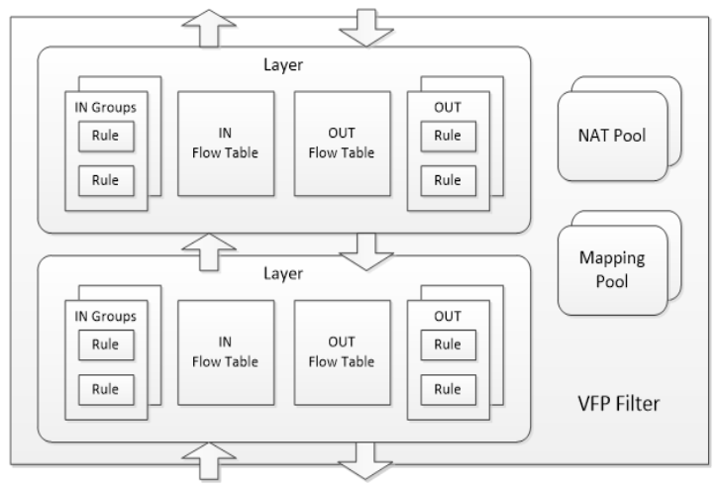
VFP Layers
VFP divides the port’s policy into layers.
Layers are the basic Match Action Tables that controllers use to specify policy.
Each layer is comprised of multiple groups (inbound/outbound IPv4 and IPv6), and each of these groups can contain multiple rules.
VFP works on a priority basis when processing rules.
Resources like NAT pools or PA-CA mapping pools are available to any layer to implement special functionality such as SLB or VNET.
Notes:
VFP divides a port’s policy into layers. Layers are the basic Match Action Tables that controllers use to specify their policy. They can be created and managed separately by different controllers. Logically, packets into a VM go through each layer one by one, matching rules in each based on the state of the packet after the action performed in the previous layer, with returning packets coming back in the opposite direction.

Slide 33
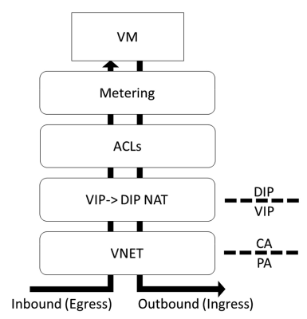
VFP layers
VNET layer creates a Customer Address (CA) and Physical Address (PA) boundary.
NAT layer translates Direct IP (DIPs) to Virtual IP (VIP).
Firewall ACLs are then applied on the DIPs of the VMs within the Customer Address space.
Metering allows for billing for ingress/egress traffic per VM.
Notes:
The figure shows layers for our SDN deployment example. A VNET layer creates a customer address (CA) / physical address (PA) boundary by having encapsulation rules on the outbound path and decapsulation rules on the inbound path. In addition, an ACL layer for a stateful firewall sits above our NAT layer. The firewall service, having placed it here with respect to those boundaries, knows that it can program policies matching Direct IP addresses (DIPs) of VMs in CA space. Finally, a metering layer used for billing sits at the top next to the VM, where it can meter traffic exactly as the customer in the VM sees it.
Layering also gives us a good model on which to implement stateful policy. We keep flow state on a layer with a hash table tracking all TCP, UDP, or RDMA connections in either direction. When a stateful rule is matched, it creates both an inbound and outbound flow in the layer flow tables, with appropriate actions in each direction (e.g., NAT or ACL).
Note: Metering layer does not exist for RS1 (Server 2016 builds).

Slide 34
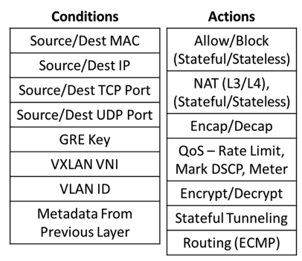
Groups and rules
Rules are organized into groups for purposes of doing transactional update and replacement operations.
Rules perform actions on matching packets in the Match Action Tables (MAT).
Rules are made up of conditions and actions.
Notes:
Rules are the entities that perform actions on matching packets in the MAT model. Rules allow the controller to be as expressive as possible while minimizing fixed policy in the data plane. Rules are made up of two parts: a condition list, specified via a list of conditions, and an action. Example conditions and actions are listed in diagram on this slide. Rules can be organized into groups for purposes of doing transactional update/replace operations, or to split a port into sub-interfaces (e.g., allow creation of independent policies for multiple Docker-style containers behind a single port).
Diagram shows some basic conditions and actions.

Slide 35
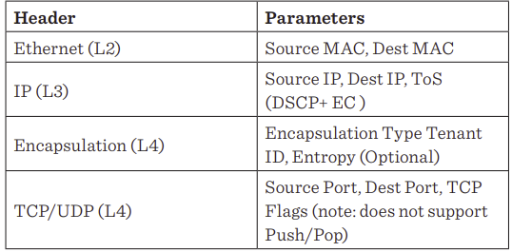
Unified flow IDs
VFP packet processor beings with parsing.
One each of the L2/L3/L4 header form a header group, and relevant fields form a single FlowID.
The tuple of all FlowIDs in a packet is a Unified FlowID (UFID).
Notes:
VFP’s packet processor begins with parsing. One each of an L2/ L3/L4 header (as defined in Table 1) form a header group, and the relevant fields of a header group form a single FlowID. The tuple of all FlowIDs in a packet is a Unified FlowID (UFID) - the output of the parser.

Slide 36
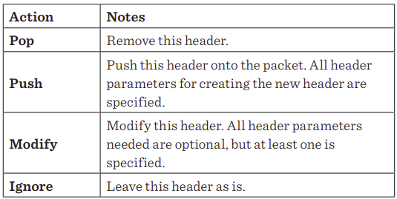
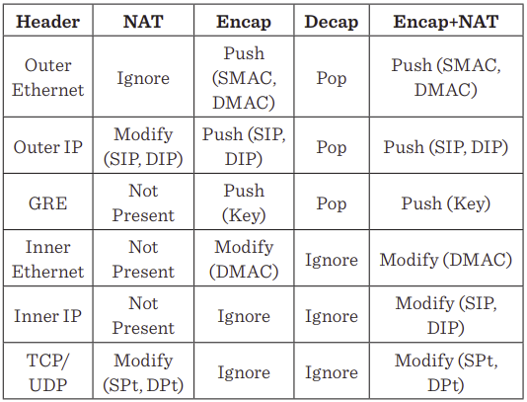
Header transposition actions
Headers Header transposition actions
Notes:
Our action primitives, Header Transpositions (HTs), so called because they change or shift fields throughout a packet, are a list of parameterizable header actions, one for each header.
Current actions defined in the table on the left:
Pop: Remove the header
Push: Push header onto packet
Modify: Modify the header
Ignore: Do nothing
The table on the right provides a sample of what happens to a packet using NAT Header Transposition for inbound and outbound flows for NVGRE encapsulation. Terminology for the diagram:
SMAC: Source MAC
DMAC: Destination MAC
SIP: Source IP
DIP: Destination IP
Spt: Source Port
Dpt: Destination Port
VFP creates an action for a UFID match by composing HTs from matched rules in each layer. For example, a packet passing the example NAT layer and the VL2 VNET encapsulation layer may end up with the composite Encap+NAT transposition in the table.

Slide 37
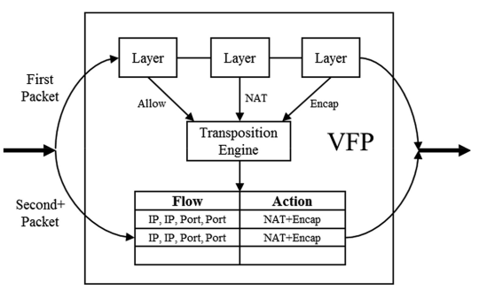
Unified flow tables
Datapath is segmented into fast and slow path.
First packet of TCP flow - slow path is taken running the transposition engine and matching at each layer.
Subsequent packets - VFP takes fast path, matching UFID and applying transposition directly.
Notes:
The intuition behind our flow compiler is that the action for a UFID is relatively stable over the lifetime of a flow—so we can cache the Unified FlowID (UFID) with the resulting Header Transpositions (HT) from the engine. The resulting flow table where the compiler caches UFs is called the Unified Flow Table (UFT). With the UFT, we segment our datapath into a fastpath and a slowpath. On the first packet of a TCP flow, we take a slowpath, running the transposition engine and matching at each layer against rules. On subsequent packets, VFP takes a fastpath, matching a unified flow via UFID and applying a transposition directly. This operation is independent of the layers or rules in VFP.

Slide 38
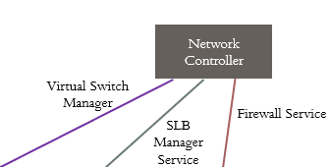
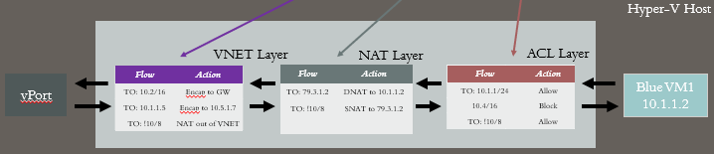
VFP flow tables: Match action tables
VMSwitch exposes a typed Match-Action-Table API to the controller:
Controllers define policy
One table (layer) per policy
Key insight: Let controller tell switch exactly what to do with which packets.
Notes:
So now that we talked about a bunch of technical terms related to how VFP operates at a base level, how does this actually translate to something we will see when troubleshooting? In this example, we have several different rules within different layers of VFP that packets will traverse through when going in/out of a VM.
VNET:
Traffic to 10.2.0.0/16 will be encapsulated and re-directed to the appropriate Gateway that is associated to the Virtual Network.
Traffic going to 10.1.1.5 will be encapsulated with PA (10.5.1.7) and traffic will be routed to PA to then be de-encapsulated and routed to VM with 10.1.1.5 address
All traffic that is NOT going to 10.0.0.0/8 will be NATed
NAT:
Traffic leaving VM1 to any address that is not equal to 10.0.0.0/8, will be Source NATed (SNAT) and Source IP address will change from 10.1.1.2 -> 79.3.1.2
Traffic incoming into VM, will have Destination NAT (DNAT) applied where traffic going to 79.3.1.2 will be routed to 10.1.1.2
ACL
Traffic

Slide 39
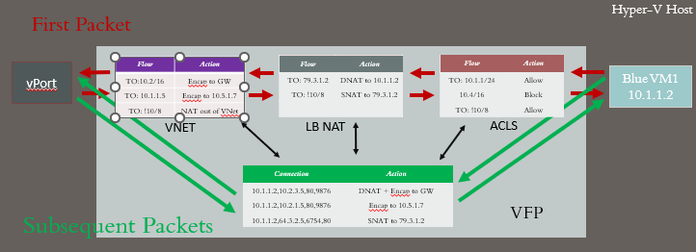
VFP flow tables: Unified flow
First-packet actions can be complex.
Established flow matches must be typed, predictable, and simple hash lookups.
Notes:
• Single hash lookup for each packet after flow is created
• Leaves room for new layers w/o perf impact (e.g. ILB, etc)
• Single flow table per VM can be sized with VM size
• All VFP actions can be expressed as header transpositions – e.g. encap/decap/l3 rewrite/l4 NAT
• Any set of header transpositions can be composed and expressed as one transposition
• Unified Flow Table: One match (per entire flowid, inner and outer) and one action (header transposition) per flow

Slide 40
Knowledge check – Virtual Filtering Platform
At which point do the VFP policies get applied to a VM?​
How are rules organized for a port?
Notes:
See answers at end of the deck.

Slide 41
Explain how to capture and view logs related to Hyper-V and VFP packet processing

Slide 42
VFP and vSwitch tracing
In scenarios where you do not believe the packet is being properly processed by the VFP or vSwitch, you can enable tracing for the component.
Enable tracing on the Hyper-V host that is hosting a guest VM attached to a tenant virtual network.
Virtualization scenario for netsh will capture the appropriate providers.
Netsh trace start scenario=virtualization.
Provider | Guid
Microsoft-Windows-Hyper-V-VMMS | 6066F867-7CA1-4418-85FD-36E3F9C0600C
Microsoft-Windows-Hyper-V-VmSwitch | 67DC0D66-3695-47C0-9642-33F76F7BD7AD
Microsoft.Windows.Hyper.V.VmsIf | 6C28C7E5-331B-4437-9C69-5352A2F7F296
Microsoft-Windows-Hyper-V-VfpExt | 9F2660EA-CFE7-428F-9850-AECA612619B0}

Slide 43
Resources
rfc-editor.orfc-editor.org/rfc/rfc7348.txt
Hyper-V Network Virtualization Technical Details in Windows Server
About Network Virtualization using Generic Routing Encapsulation (NVGRE) - Windows drivers
Hyper-V Network Virtualization Technical Details in Windows Server

Slide 44
Knowledge check answers (1/3)
Learning objective | Questions | Answers
1: Hyper-V Network Virtualization (HNV) | How are policies programmed in HNV v1 vs HNV v2?​ | HNV v1 is programming using WMI. HNV v2 leverages NC and NCHostAgent​.
2. Virtual networks and subnets | How is isolation achieved between Virtual Networks? ​ Can subnets within the same Virtual Network communicate with each other? ​ Can subnets in different Virtual Networks communicate with each other? ​ What is the logical network called that the encapsulated traffic traverses?​ | NVGRE or VXLAN overlay. Subnets are isolated with Network Identifier (VNI/TNI) and bound to a Virtual Network Routing Domain ID (RDID)​. Yes​. No​. Provider Logical Network​.

Slide 45
Knowledge check answers (2/3)
Learning objective | Questions | Answers
3. Switching and routing | How does a VM learn L2 routes to another VM in the same subnet?​ What is the IP address of the default router for a VM deployed on a virtual network?​ What is required to route traffic to or from a virtual network and physical network?​ | Leverages standard L2 processes by sending an ARP to locate the remote VM. VSwitch will intercept the ARP and respond with ARP information received by NCHostAgent which maintains a list of entries.​ IP address of the Distributed Router which is typically the first IP address of the virtual network . Virtualization Gateway. Either via Load Balancer or NAT through SLB MUX or via Virtual Gateway through RAS Gateway.​

Slide 46
Knowledge check answers (3/3)
Learning objective | Questions | Answers
4. Packet encapsulation | What is the Customer Address? ​ What is the Provider Address? ​ What is the default encapsulation type for virtual networks managed by Network Controller? | Customer address is the private IP addresses associated with VMs deployed in the virtual networks.​ Provider Address is the host IP address used for the Provider Logical Network. This is what carries the tenant traffic between host servers and is not visible to the VMs.​ VXLAN​.
5. Virtual Filtering Provider (VFP)​ | At which point do the VFP policies get applied to a VM? ​ How are rules organized for a port? ​ | VFP policies are attached to the vPort associated with VM and are applied when traffic is flowing between the vSwitch and vNic.​ Rules are associated with groups which are associated with layers.​

Slide 47
Summary
In this module, you learned about:
Hyper-V Network Virtualization (HNV)
Virtual networks and subnets
Switching and routing
Packet encapsulation
Virtual Filtering Platform (VFP)
VFP and vSwitch tracing

